Slide 1
Problems that Today’s Manufacturing Industries
are facing?
ZAIN ALI (CEO)
SYEDA SARA (CFO)
M HAMZA (CMO)
SADIA (CTO)
CHIEF EXECUTVE
CHIEF OF FINANCE
CHIEF OF MARKEING
CHIEF TECHNICAL OFFICER

Slide 2
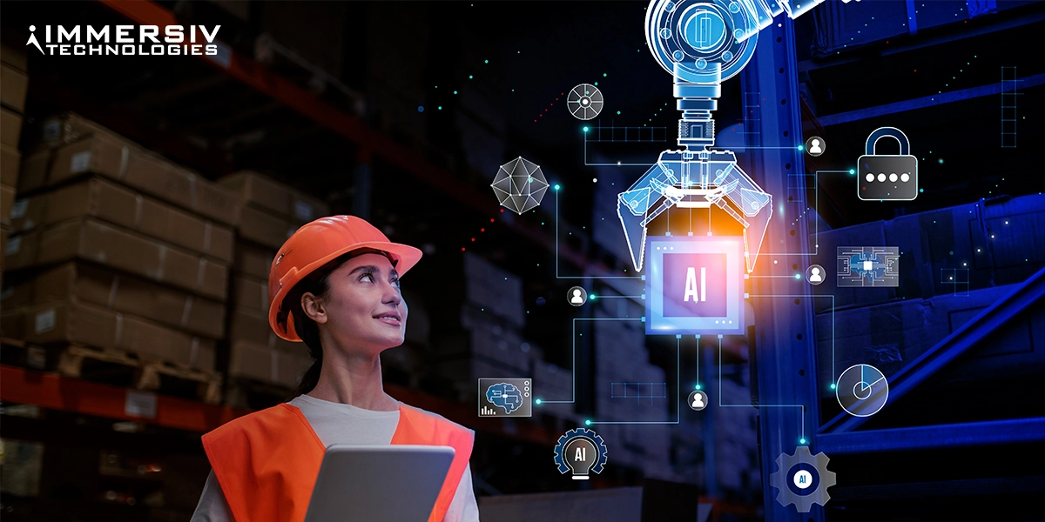
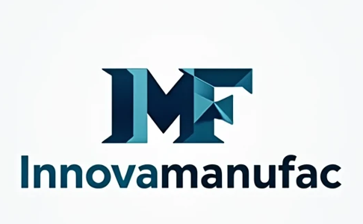
Software company

Slide 3

MEET OUR TEAM
ZAIN ALI (CEO)
SYEDA SARA (CFO)
M HAMZA (CMO)
SADIA (CTO)
CHIEF EXECUTIVE
CHIEF OF FINANCE
CHIEF OF MARKETING
CHIEF TECHNICAL OFFICER

Slide 4
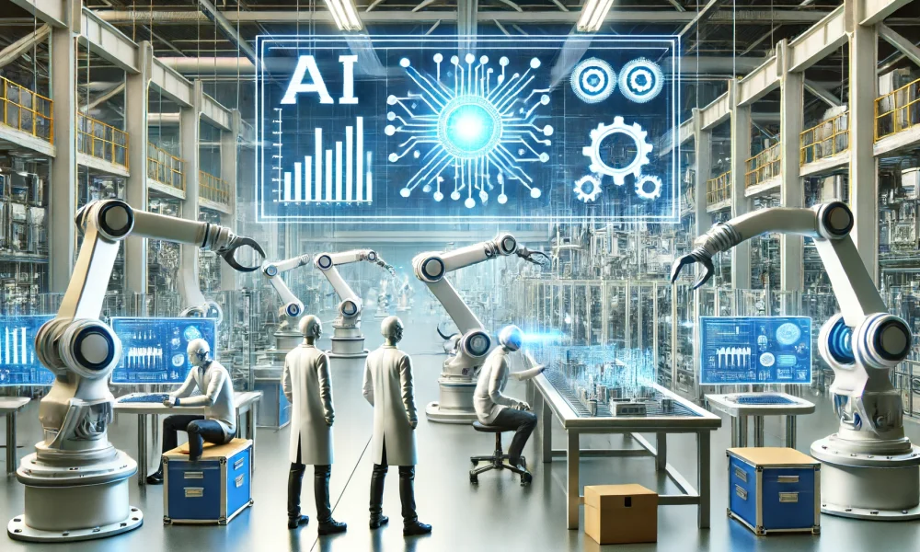



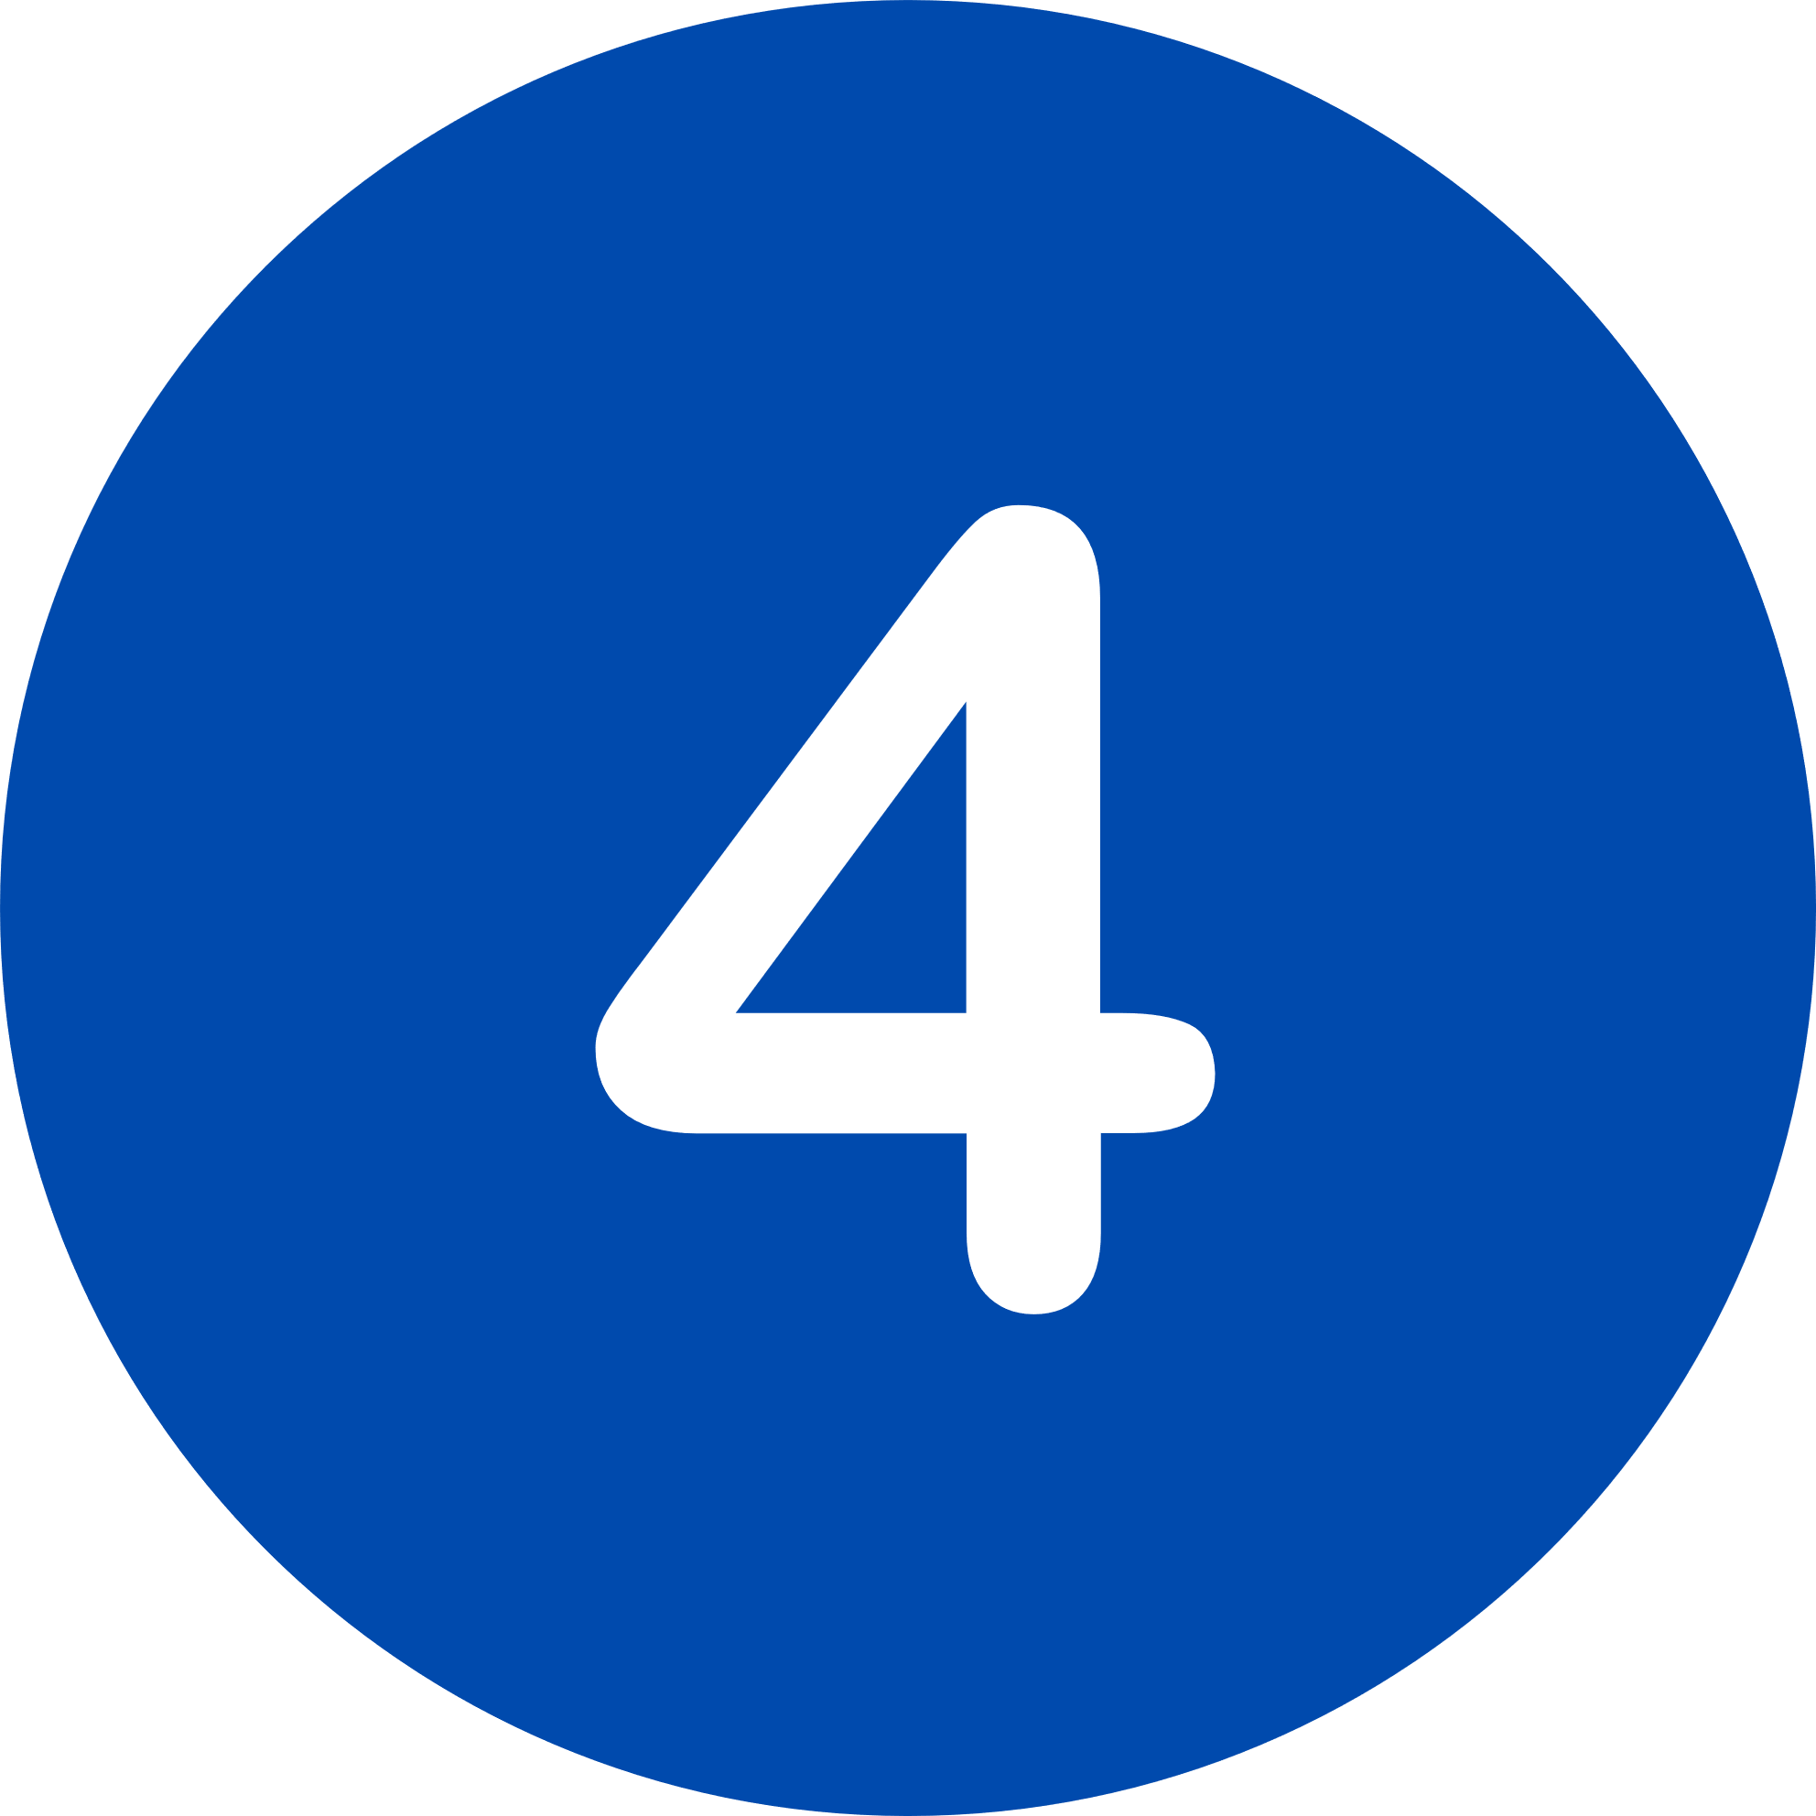

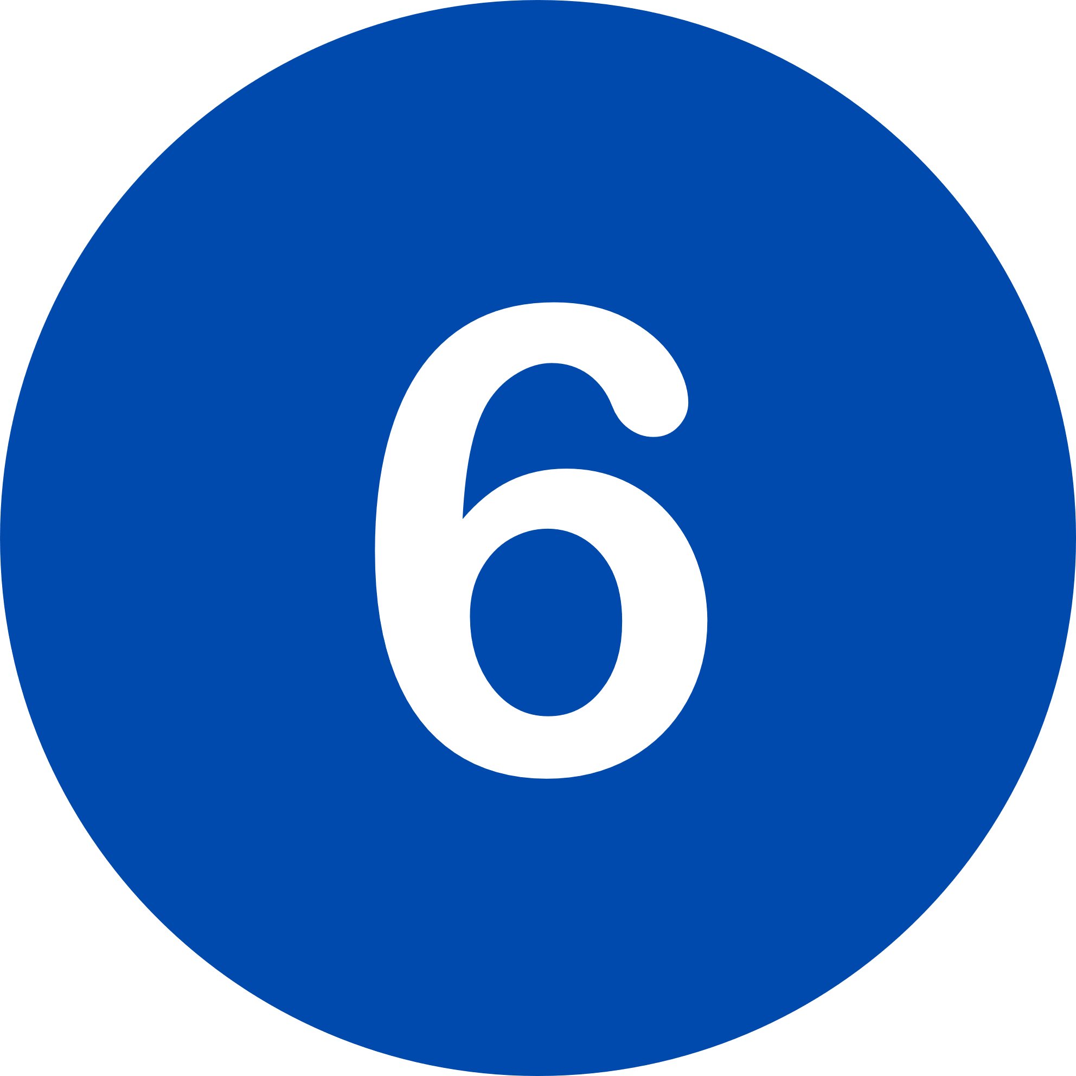
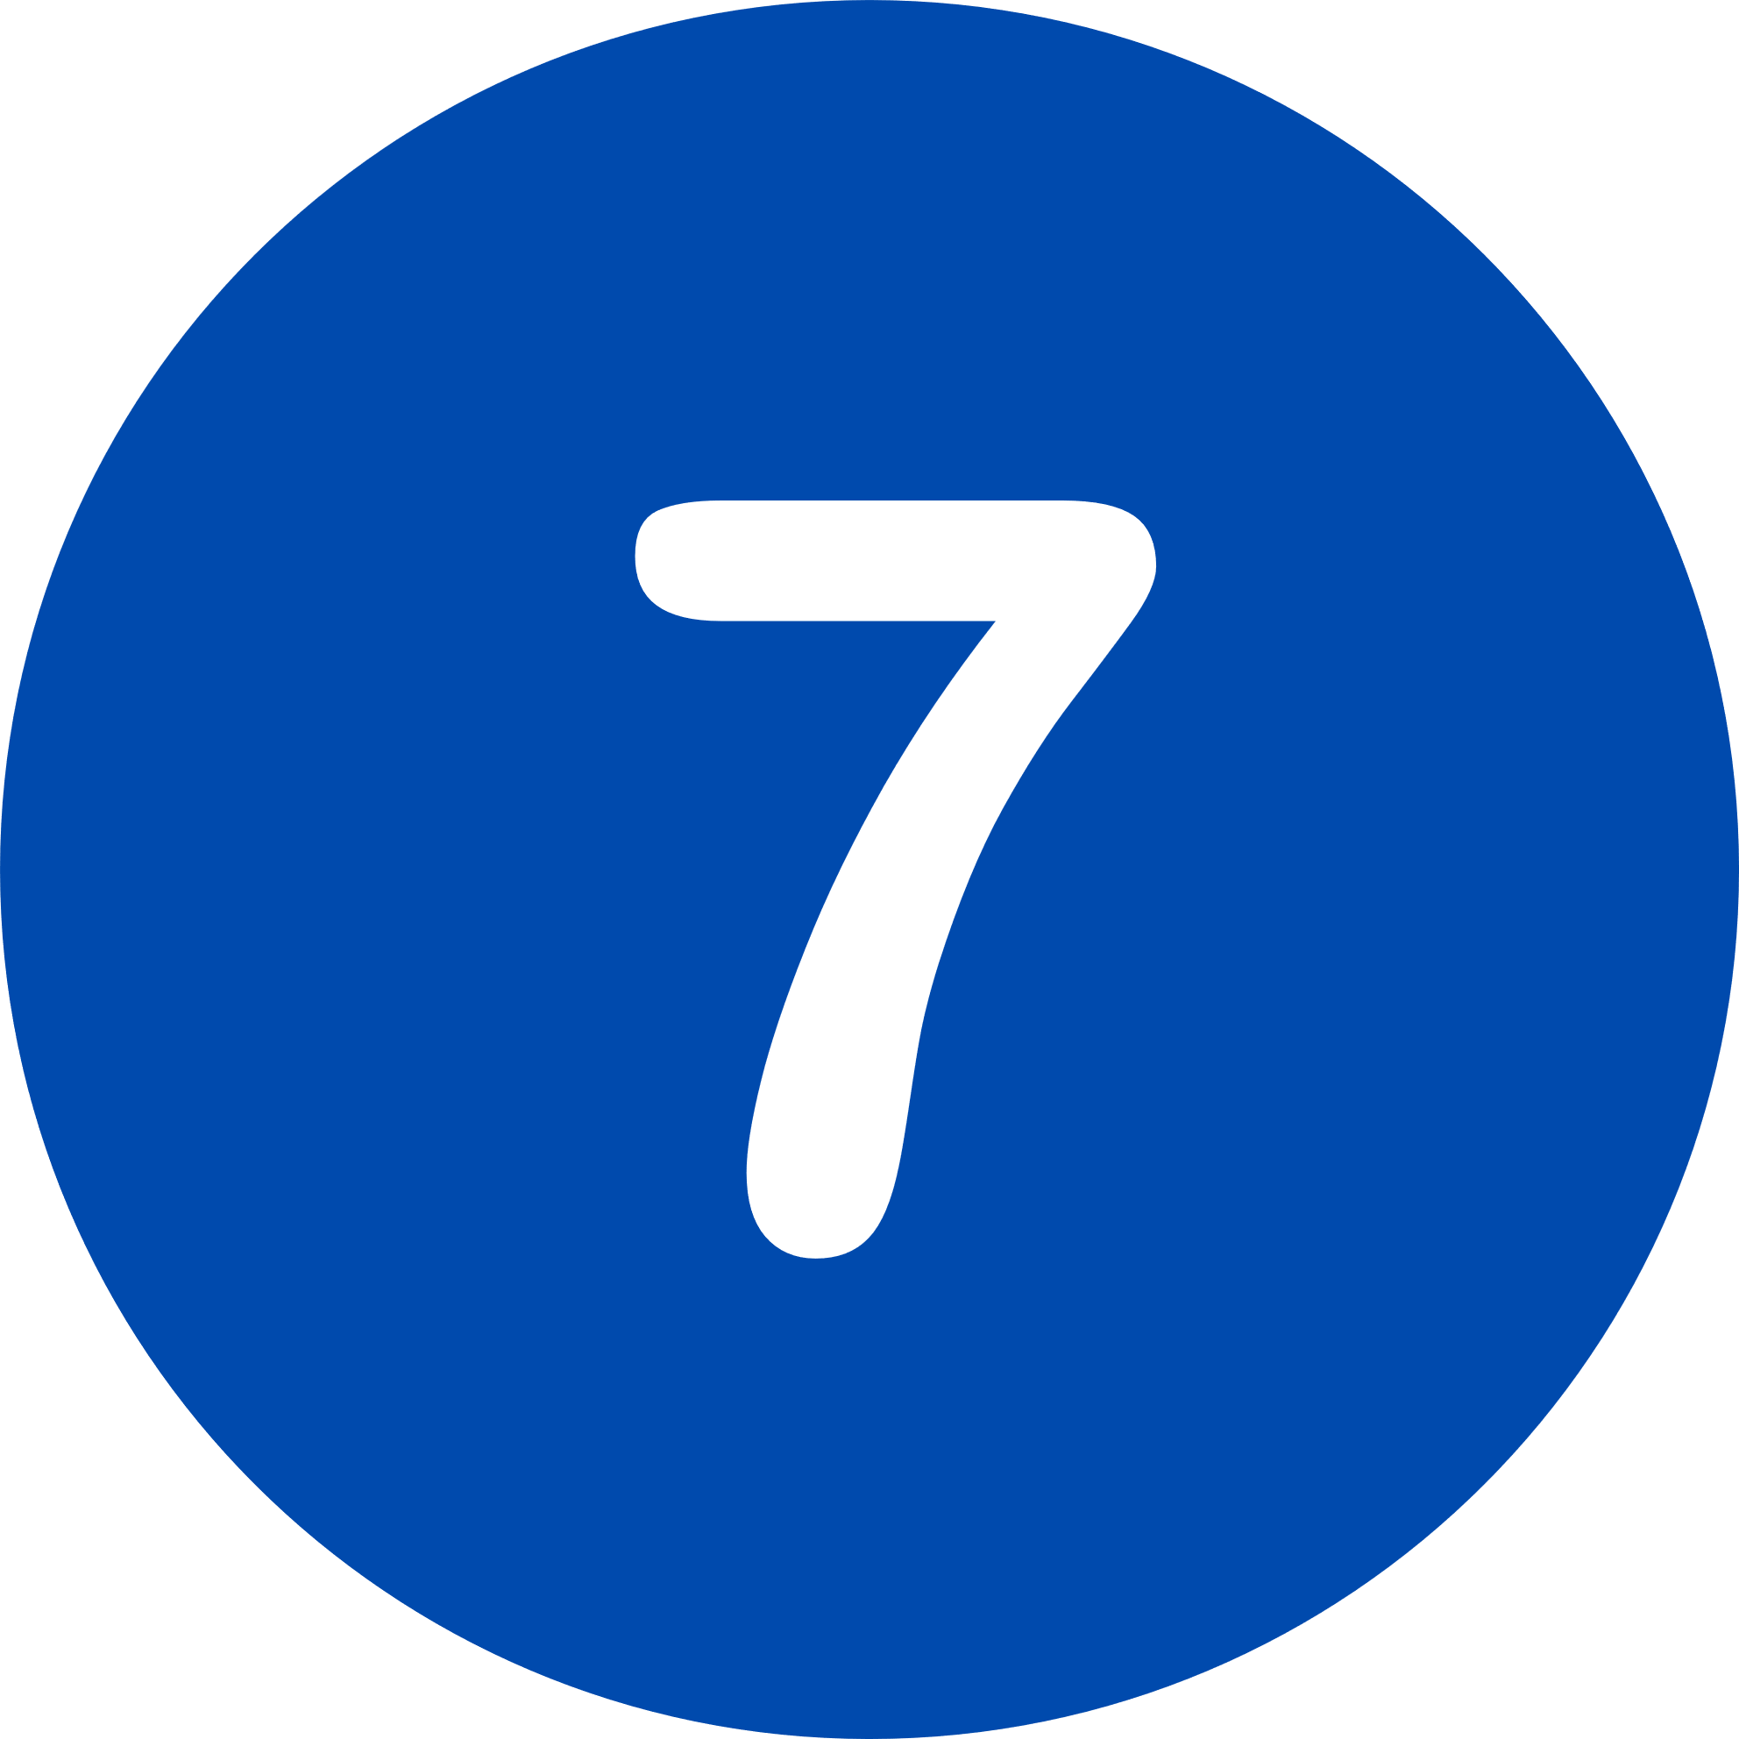
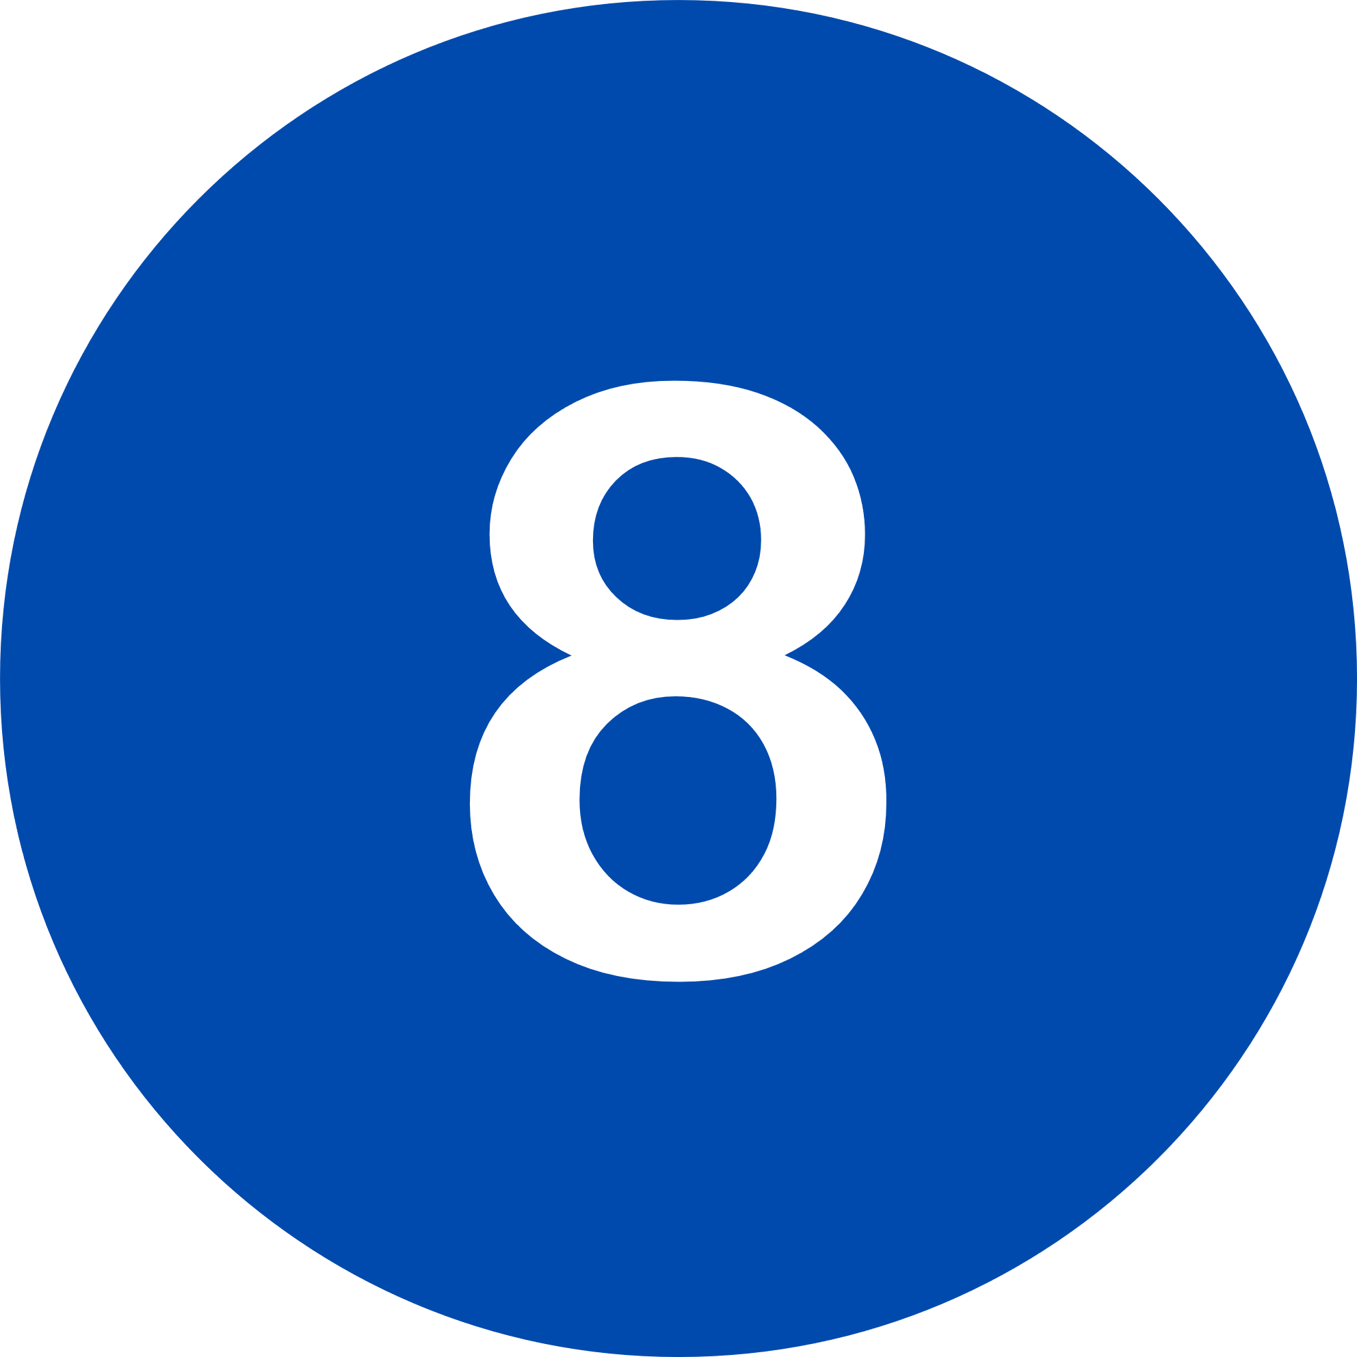
CONTENTS
OUR TEAM
COMPANY OVERVIEW
OUR SOFTWARE PRODUCT
ROLE OF CEO
TECHNICAL OVERVIEW
FINANCIAL OVERVIEW
MARKETING STRATEGY
CONCLUSION

Slide 5

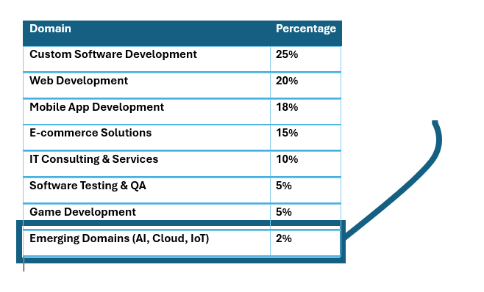
COMPANY OVERVIEW
Suggest Massive gap for business opportunity.

Slide 6
Major focus of Innovamanufac
Predictive Maintenance
Quality Assurance
Supply Chain Optimization
Workforce Productivity

Slide 7
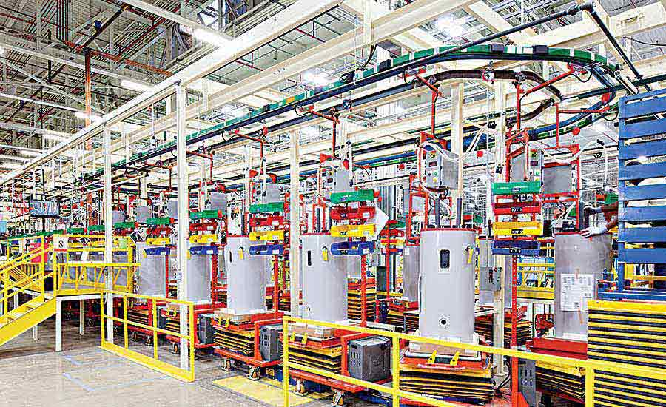
predictive maintenance in InnovaManufac
Machine learning to analyze data
sensors on gas turbines and jet engines
temperature, vibration, and pressure
InnovaManufac solution will predict failure

Slide 8


ROLE OF CEO
Set Vision and Strategy:
Oversee Development:
Lead Innovation:
Manage Stakeholders
Ensure Resource Allocation:

Slide 9

TECHNICAL OVERVIEW BY CTO
Role of CTO (CTO's Responsibilities)
Define technical roadmap and align with business goals.
Oversee AI development for predictive maintenance and load balancing.
Design scalable and fault-tolerant system architecture.
Manage multidisciplinary teams and foster collaboration with stakeholders.
Key Features of the AI System
Predictive maintenance using AI for overheating prevention.
Real-time optimization through load balancing.
Integration of IoT sensors, edge computing, and cloud systems.
Scalable and efficient architecture for industrial environments.
Collaboration and Stakeholders Alignment
CEO: Align technical strategy with company vision
CFO: Manage budgets for R&D, hardware, and infrastructure
CMO: Highlight technical features for marketing campaigns

Slide 10
TECHNICAL OVERVIEW BY CTO
Cybersecurity and Compliance
Robust cybersecurity measures to prevent breaches.
Compliance with regulations (e.g., ISO standards).
Fail-safe mechanisms to maintain system reliability.
Research and Development (R&D)
Explore emerging technologies:
Digital Twins for virtual testing.
Blockchain for secure data management.
Edge Computing for enhanced local decision-making.
Long-term focus on advanced solutions for scalability.
Achievements and Goals
Achieve technical innovation and market leadership.
Provide a world-class AI-driven automation solution.
Set a new benchmark in machine automation.

Slide 11

FINANCIAL OVERVIEW BY (CFO)
Fundraising and Investment Gathering
Approach large corporations that invest in tech startups, Prepare a compelling pitch deck showcasing market potential and ROI.
Financial Planning for Development Stages:
ensures the project's development progresses smoothly and within budget. Will allocate resources efficiently across different stages, securing necessary funding at each phase.
Revenue Model and ROI Plan:
Will plan revenue streams like subscription, licensing fees and sales, and will target ROI projections for 1st year and up-to 5 years highlighting main target and minimum projection (not less than that)
Collaborate with team:
Will host meetings with our team like CTO, and CMO to track financial milestones, and will reward teams based on their performance for motivation, leading to more financial success of the company
Will also perform Financial Risk Management to protect our company from bankruptcy or legal penalties by investing in robust technical and legal measures

Slide 12

MARKETING STRATEGY BY CMO
Define the Target Audience
Like Manufacturing companies in textiles, automotive, and food enterprises, looking for AI-based efficiency solutions.
Present Key Value Proposition
The key value proposition outlines the primary benefits your AI automation software offers to potential clients. Like Cost Savings through Automation and Predictive Maintenance.
Referral Marketing Strategy
Profit sharing for leads converted to customers to the individuals, distributors/vendors, and train referrers also through referral portal.
Digital Marketing
SEO, SMM, and Email Marketing

Slide 13
MARKETING STRATEGY (Cont)
Traditional Marketing Methods for Developing Markets
Like Direct Sales via Industrial Events(face-to-face interaction), Local Advertising and Cold Outreach
Establishing Local Presence
Make regional sales representative by partnering with local sales agents familiar with industrial networks.
By integrating referral marketing with digital and traditional approaches, this plan ensures high lead generation while building trust and awareness in the local industrial market and get competitive advantage.

Slide 14
CONCLUSION
POINT 1
Description, takes more time to write, and is comprehensive. Lenders and investors commonly request this plan.
POINT 2
Description, takes more time to write, and is comprehensive. Lenders and investors commonly request this plan.
POINT 3
Description, takes more time to write, and is comprehensive. Lenders and investors commonly request this plan.
POINT 4
Description, takes more time to write, and is comprehensive. Lenders and investors commonly request this plan.

